Slide 1

Measurable Outcomes Through Industry Certifications

Slide 2
Session Agenda
Student/CTE Value of Credentialing
    Articulation/College Credit
    Industry Standards/Certification Overview:
    Implementing Industry Standards-Based Programs
    Q & A

Slide 3
From the White House
“Occupations requiring higher educational attainment are projected to grow much faster than those with lower education requirements, with the fastest growth among occupations that require an associate’s degree or a post-secondary vocational award.” (Emphasis added)
Preparing the Workers of Today for the Jobs of Tomorrow
http://www.whitehouse.gov/assets/documents/Jobs_of_the_Future.pdf

Slide 4
From Georgetown University
“In addition to these program interventions
for adults and postsecondary students who are
working, we need to revive high school career and technical education programs as alternative pathways to postsecondary education and training or to industry-based certificates and certifications that make students employable after high school.” (Emphasis added)
- Postsecondary Education and Training As We Know It Is Not Enough. http://cew.georgetown.edu/uploadedfiles/412071_postsecondary_education.pdf

Slide 5
From Washington State (I-BEST)
“The study identified a “tipping point” of at least one year of college credit and a credential as the threshold for earnings gains, to meet employer demands for skilled workers and prepare students for moving even higher in their post-secondary attainment.” (Emphasis Added)
- Washington SBCTC – Research Report No. 08-1
http://www.sbctc.edu/college/education/resh_rpt_08_1_student_achieve_basic_skills_003.pdf

Slide 6

From Harvard University
“27% of people with post-secondary
licenses or certificates—credentials short of
an associate’s degree—earn more than the
average bachelor’s degree recipient.”
Pathways to Prosperity (Feb. 2011)
http://www.gse.harvard.edu/news_events/features/2011/Pathways_to_Prosperity_Feb2011.pdf

Slide 7
From California State University
“Students who earn credentials in occupational programs can have substantial earnings advantages over those earning traditional academic degrees” (Emphasis Added)
- California State University - Sacramento
http://www.csus.edu/ihelp/PDFs/R_Road_Less_Traveled_02_11.pdf

Slide 8
Student Value - Employability
Top-tier staffing agency reports:
Twice as likely to be placed
50% more likely to be hired on full time
Average 10-15% higher pay
Time Magazine Report
http://www.time.com/time/magazine/article/0,9171,1952331,00.html

Slide 9

Student Value – Career Readiness
80% of entry-level information worker tasks
85% of supervisors report…
  More productive
  Require less supervision
93% Become team resources
89% Are more satisfied at work
  Keeping/staying with their jobs
"Proportionally, more kids have lost jobs in the past few years than the entire country lost in the Great Depression."
- Andrew Sum in Time Magazine
Jan 18, 2010

Slide 10
Relevance Barometers
Monster.com
Careerbuilder.com
Notes:
This isn’t scientific, but it provides a good glimpse into the relative demand for skills in your area. Try typing “Microsoft Office”, “Adobe”, or other skills in the keyword search in your area to see what the market needs.

Slide 11
Student Value – HS Academics
Lower Drop-out Rates
  NYC CTE – 4x Lower
Increased Post-Secondary Enrollment
  NYC CTE – 92%
Perceived Program Value
  NYC CTE –600 openings received 10,000 applicants

Slide 12
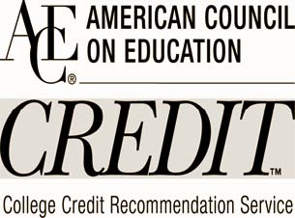
Student Value – College Credit
Students can receive college credit through:

Slide 13
ACE Colleges in California
California ACE Credit Schools
Allan Hancock College | Holy Names University
Allied American University | Humboldt State University
Biola University | John F. Kennedy University
California Lutheran University | La Sierra University
California State Polytechnic University--Pomona | Los Angeles Film School
California State University, Bakersfield | Los Angeles Harbor College
California State University, Chico | Los Medanos College
California State University, Dominguez Hills | Menlo College
California State University, East Bay | MiraCosta College
California State University, Fullerton | Monterey Peninsula College
California State University, Long Beach | Mount Saint Mary's College
California State University, Los Angeles | Mount San Antonio College
California State University, Northridge | National University
California State University, Stanislaus | NewSchool of Architecture and Design
Coastline Community College | Pacific Union College
Cogswell Polytechnical College | Palomar College
College of the Canyons | Patten University
Cuesta College | Point Loma Nazarene University
De Anza College | Reedley College
Diablo Valley College | San Diego City College
Dominican University of California | San Diego State University
Don Bosco Technical Institute | San Francisco Art Institute
Fielding Graduate University | San Francisco State University
Fresno City College | St. Joseph's College
Gavilan College | TUI University
Golden Gate University | University of California, Berkeley
Golden West College | University of La Verne
Hartnell College | University of Redlands
Heald Colleges | University of San Francisco
 | Woodbury University

Slide 14
CTE Program Value
Quantifiable Student Learning Outcomes
  Align with Perkins & Other Funding Requirements
  Simplifies End of Year reporting
  Standardization
Professional Development for Staff & Faculty
  Fulfill CTE Credential Requirement for Industry Exp.
Articulation – Rio Hondo – IC3, Chaffey College - MOS

Slide 15
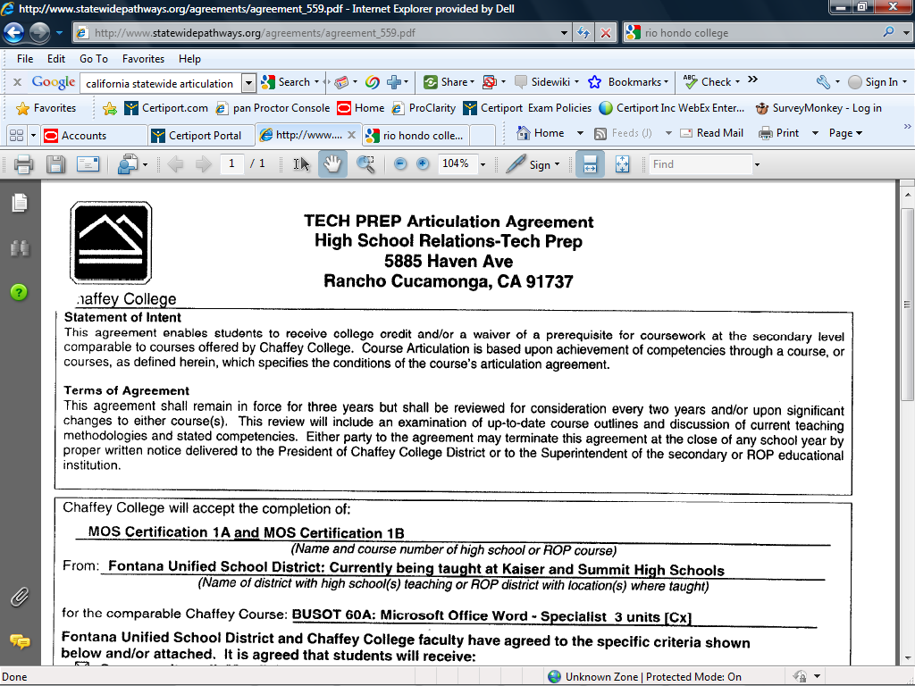

Slide 16
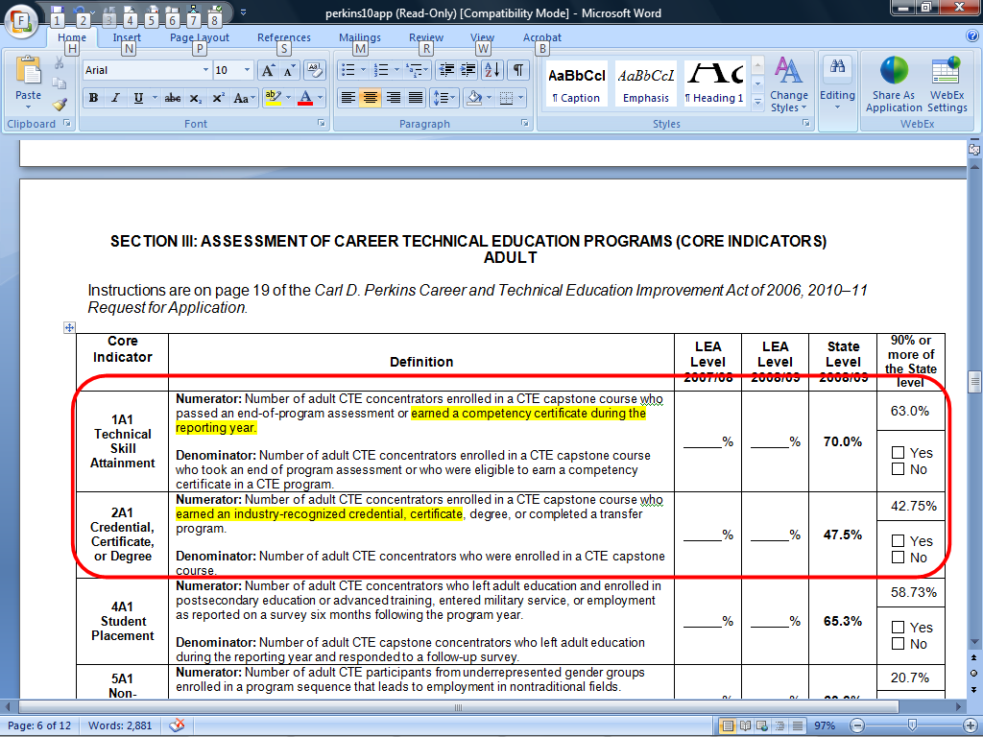
Fulfill Perkins Adult Ed Core Indicators

Slide 17
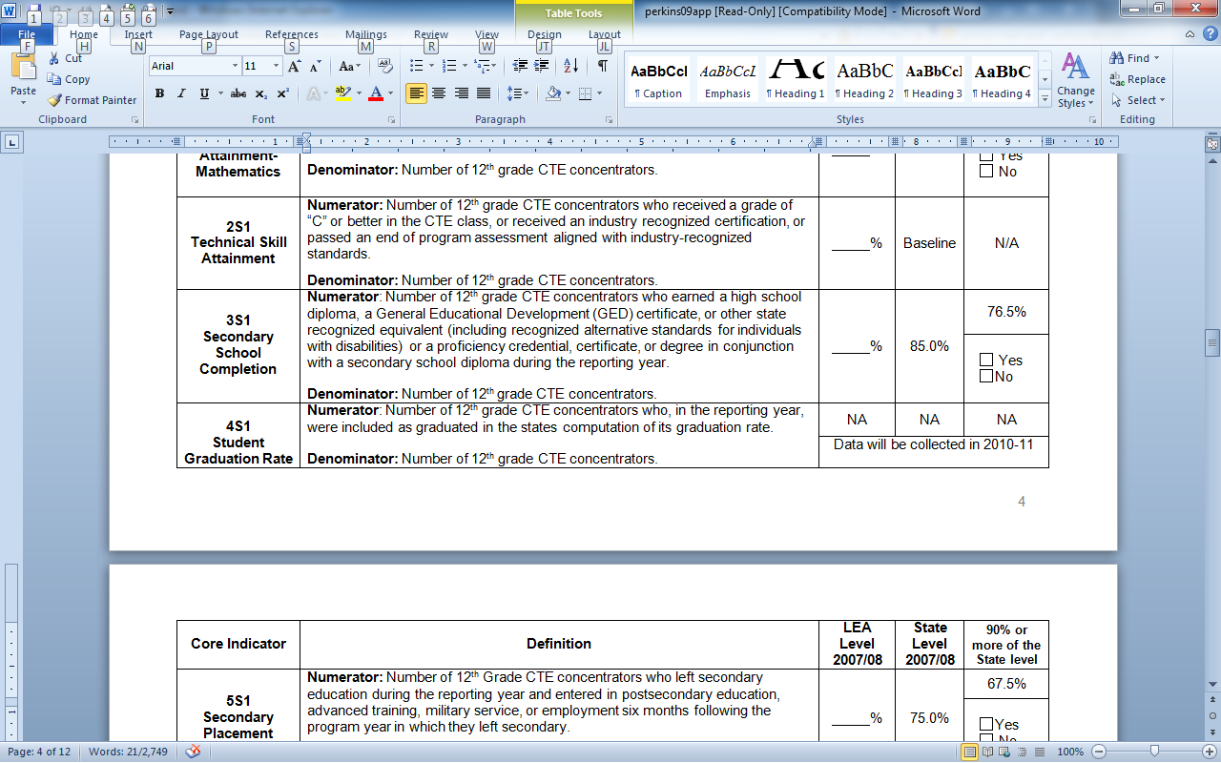
Fulfill Perkins 2S1 and 5S1 Reporting Requirements

Slide 18

CPA End of Year Reporting
What used to be Part A (Now part of CAPAAR)

Slide 19




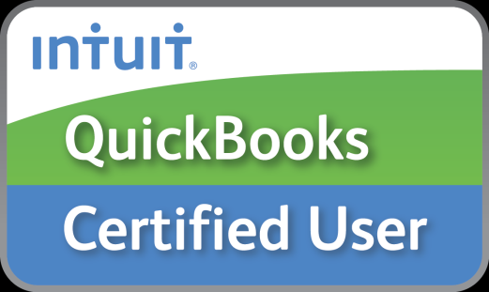
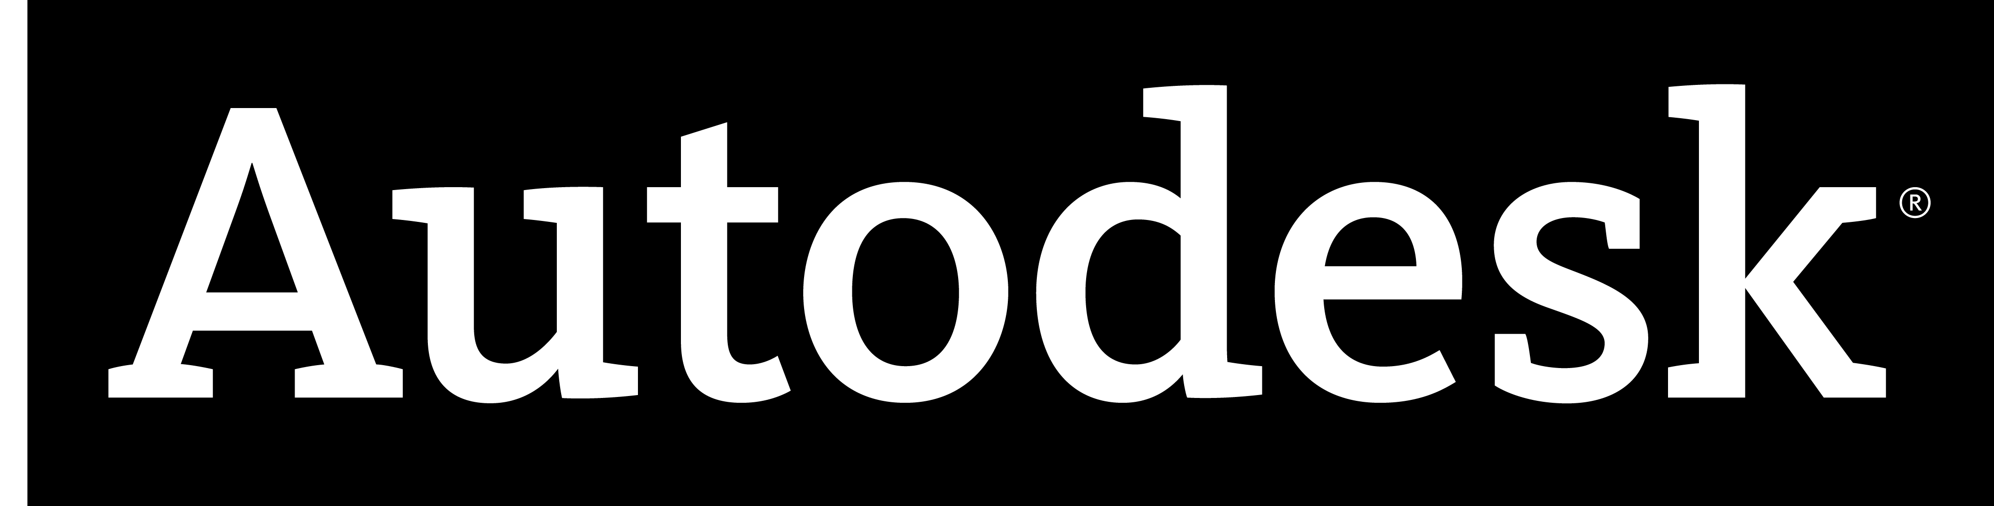
Industry Standards

Slide 20
Microsoft® Office Specialist

Slide 21


Slide 22
The MOS Program
  Largest Certification Program on the Planet
  “Ideal” Candidates for Certification
    ROP/CTE Students
    Academy Program Students
    Instructors and Staff
  Microsoft Office Specialist (MOS)
  Word, Excel, PowerPoint, Outlook, Access (SharePoint & One Note in 2010)
  - Microsoft Office 2010
  - Microsoft Office 2007
  - Microsoft Office 2003

Slide 23

MOS Exam Characteristics
This is what to expect -
Performance-based exam
55 minute length
20-30 test items with one or more tasks
Score required to pass varies with exam
(65-80%)
Skills measured are posted on Microsoft’s
website

Slide 24
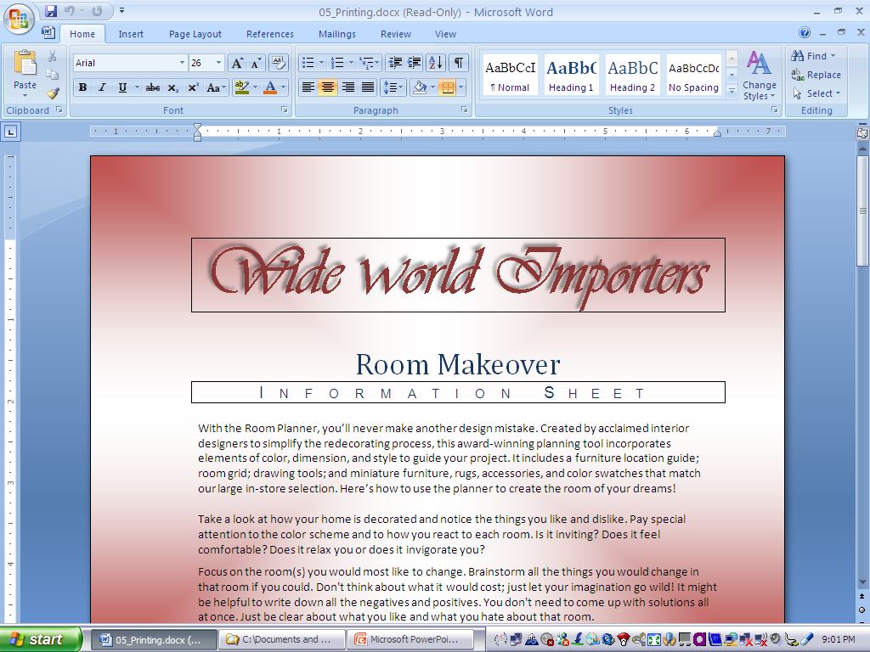
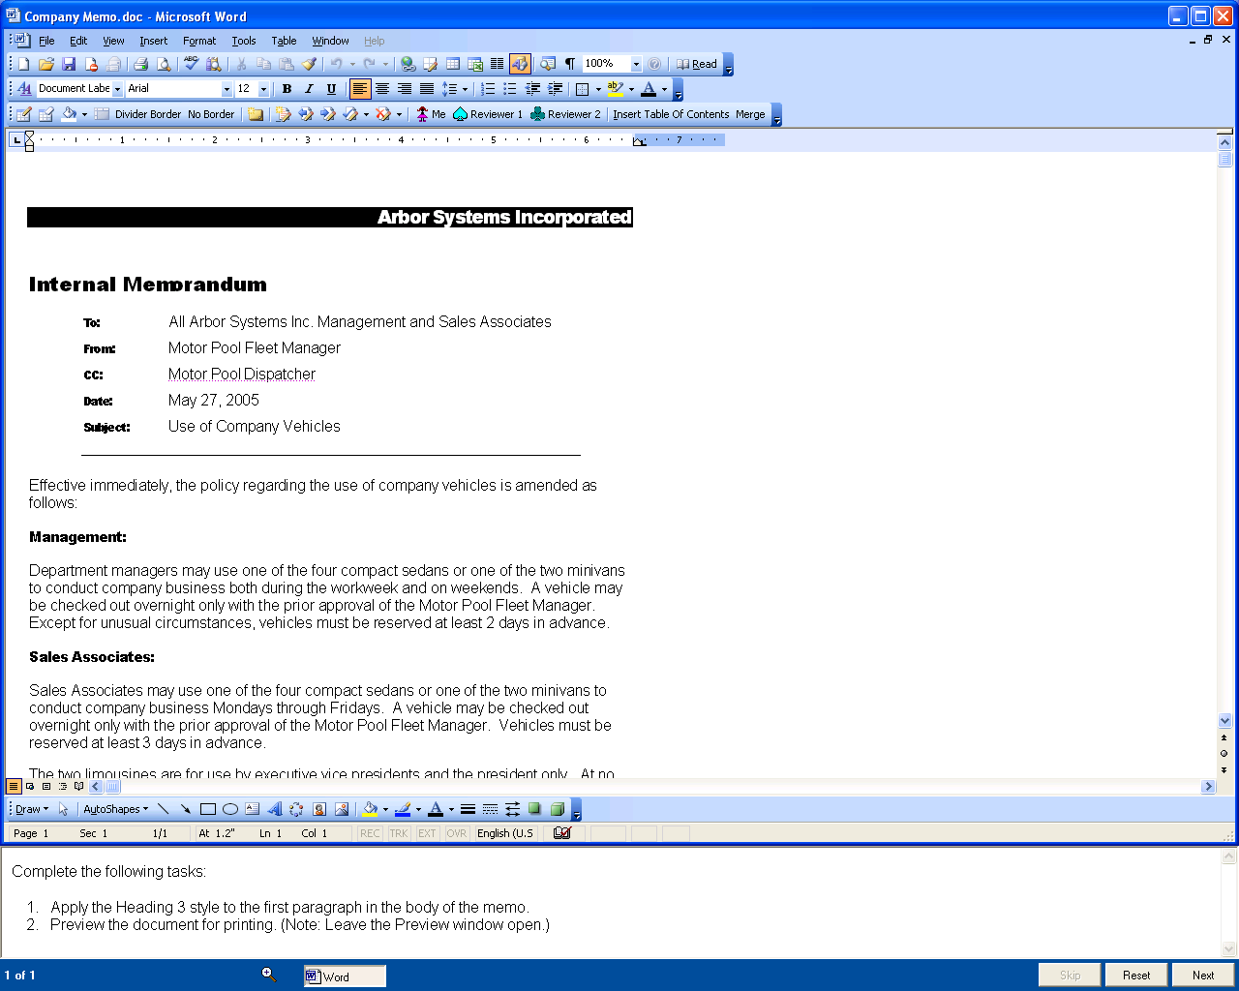
Sample Exam Question
“Live” Office application appears in upper portion of window. All features work except Help!
Task pane is at bottom. Has counter, timer and buttons for Skip, Reset and Next.
48:15

Slide 25
Exam Objectives
MOS 2010 Word – Core
MOS 2010 Excel – Core
MOS 2010 PowerPoint
MOS 2010 Outlook
MOS 2010 Access

Slide 26
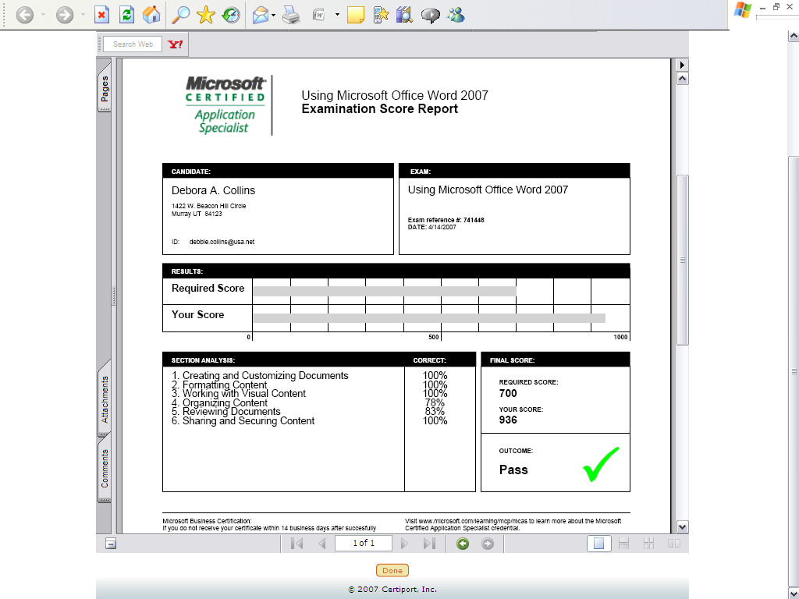
Sample Exam Score Report
The score report shows you the required passing score, your score and percentage performance in each topic area.
Like all Microsoft exams, a perfect score is 1000.

Slide 27
Who’s Doing It Now?
K-12
Dozen+ in LAUSD
Elk Grove USD
Chaffey Joint Union High School District
Sweetwater Union HSD Adult Ed
Many Partnership Academies, ROP & CTE
Post-Secondary
~30 CA Community Colleges

Slide 29
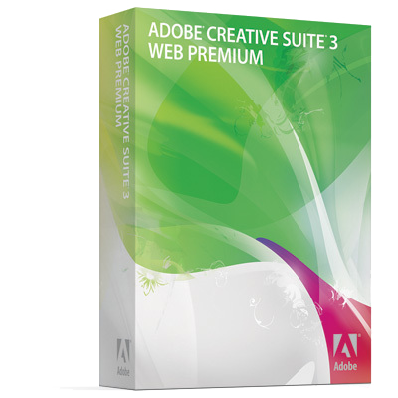
“Tools” for Creative Design
Most common tools for web, graphics, audio, video and animation.
  Dreamweaver
  Flash
  Photoshop
  Premier (CS5)

Slide 30

The ACA Programs
  Digital Literacy Skills Certified
    Use of Photoshop, Dreamweaver and Flash & Premier*
    Exams available in CS3, CS4 or CS5 versions
  Appropriate Courses for Certification
    Digital Photography Courses
    Photoshop/Design Courses
    Web Design Courses
    *Premiere exams is available in CS5 only

Slide 31
Adobe® Exam Characteristics
This is what to expect -
Mix of multiple-choice and simulations
50 minute length
39-41 test items
Score required to pass varies with exam
(Between 65 and 75%)
Skills measured are posted on Adobe
website

Slide 32
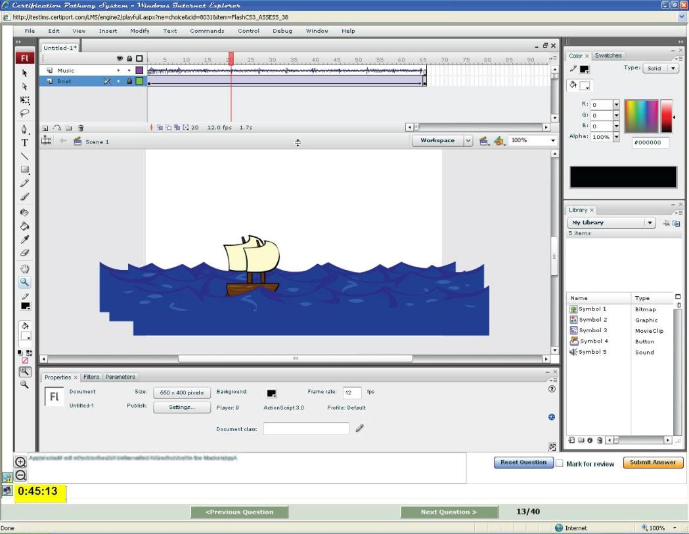
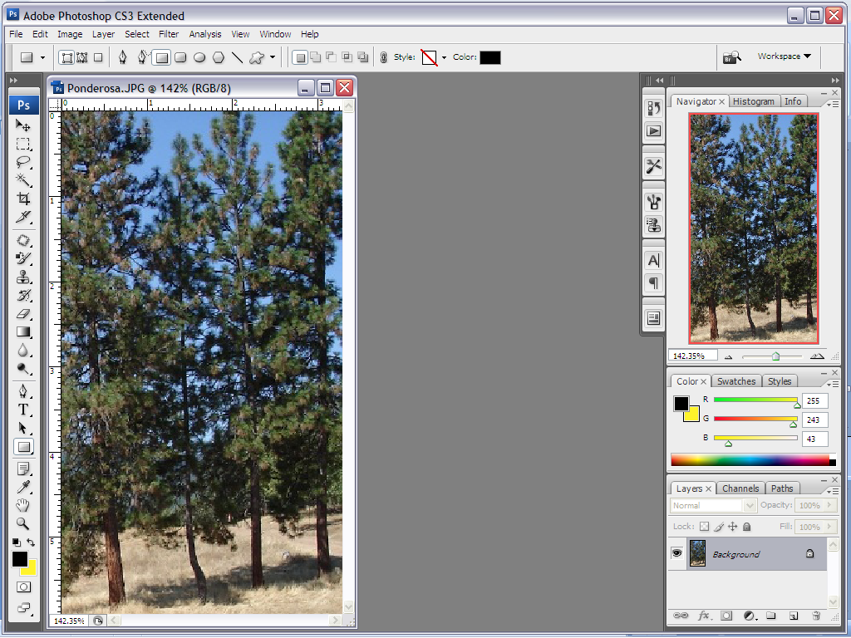
Sample Adobe Exam Items
Notes:
32

Slide 33



Adobe Teaching Resources - FREE
Visual Design: Foundations of Design and Print Production
A yearlong, project-based curriculum that develops communication career skills in print production and graphic design.
Digital Design: Foundations of Web Design
A yearlong, project-based curriculum that develops communication career skills in website design and production.
Digital Video: Foundations of Video Design and Production
A yearlong, project-based curriculum that develops communication career skills in digital video production.
http://www.adobe.com/education/instruction/teach/digitalcareers.html

Slide 34


Slide 35
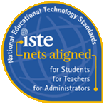
IC³ Program
  Digital Literacy Certified in 3 Areas
    Computing Fundamentals, Key Applications, Living Online
  IC³ = Foundational Certification for
    Office Workers
    Design Workers
    IT Professionals
  Appropriate Courses for Certification
    Introduction to Computers
    Basic Microsoft Office Courses
    Internet Use Courses

Slide 36
IC³ Consists of 3 Exams
  Computing Fundamentals Exam
    Basic knowledge of computer hardware, software and operating systems
  Key Applications Exam
    Use of word processing, spreadsheet and presentation software
  Living Online Exam
    Basic knowledge of computer networking, email, safe use of the Internet, and the impact of computers on society
Notes:
36

Slide 37
IC³ Exam Characteristics
This is what to expect -
Mix of multiple-choice, simulations and matching questions
45 minute length
45 test items with one or more tasks
Score required to pass varies with exam
(most IT exams range from 65-80%)
Source: US Dept. of Education, October 2000
Skills measured are posted on Certiport’
website

Slide 38
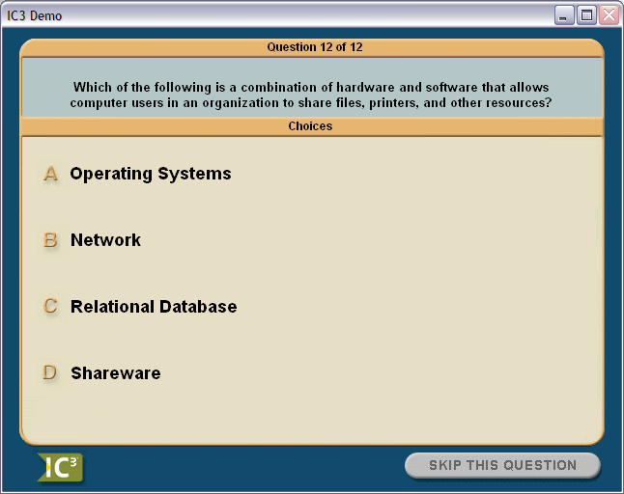
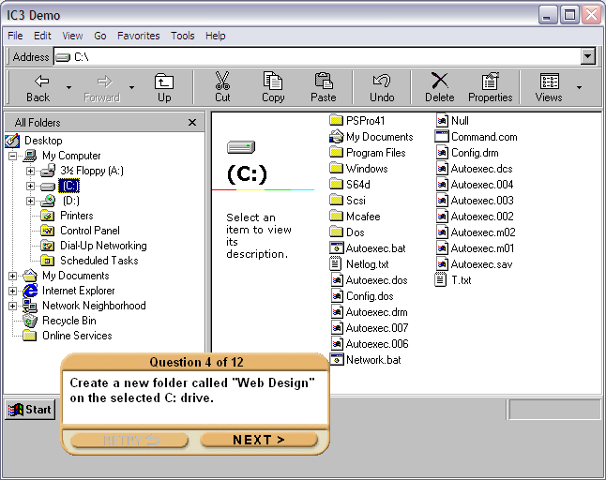
Sample IC³ Exam Items
IC³ Certification Pathway

Slide 39
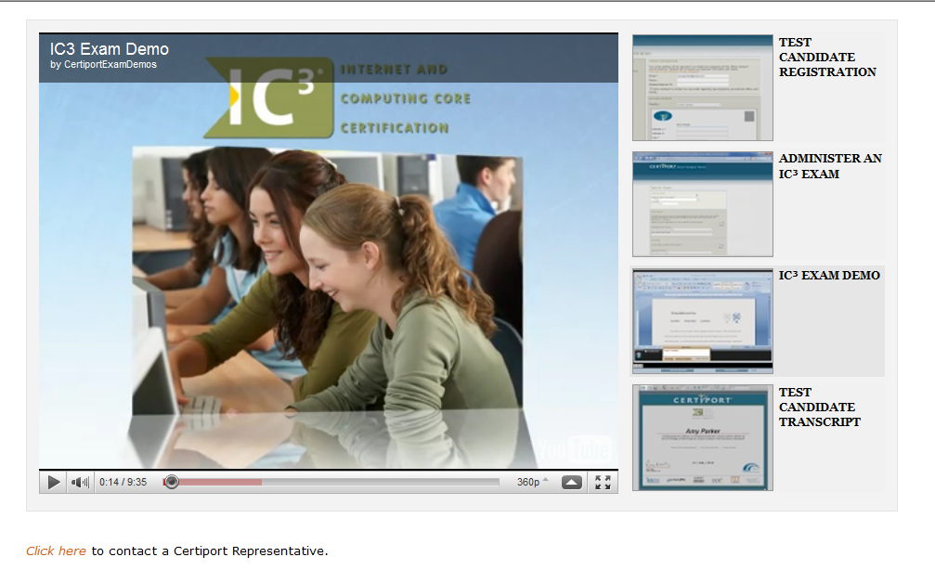
See IC³Exam Demo
http://www.certiport.com/Portal/common/htmllibrary/Sales-Video-Demos/demo_ic3.html

Slide 40
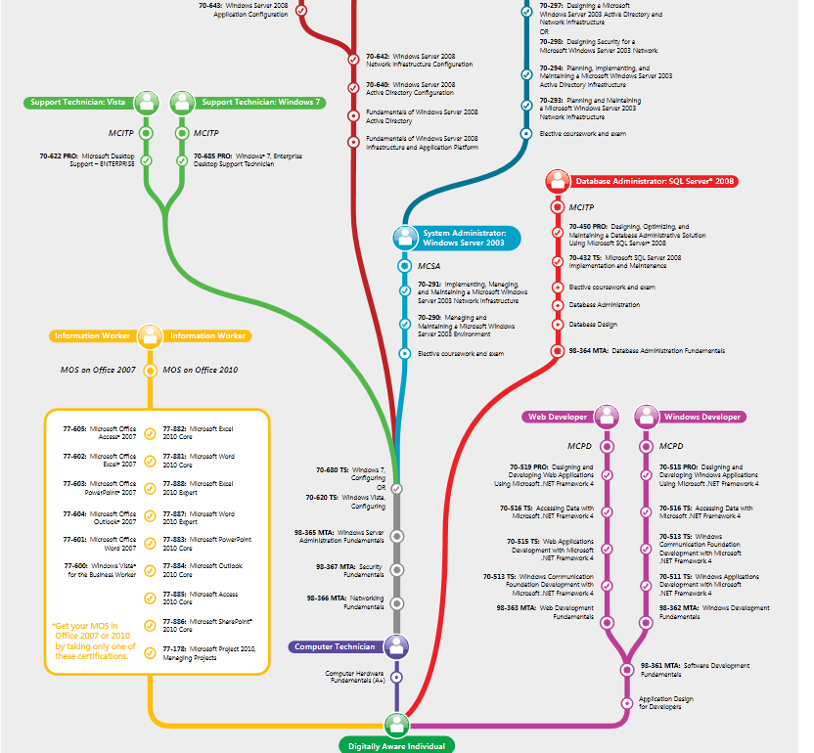

Slide 41


Slide 42
Exam Overview
  CompTIA Strata = Foundational IT Credential for
    Tier-1 Helpdesk Staff
    Students Pursuing IT Pathways
    Technically Demanding Careers
      Medical Office Support
      Office Administration
      Communication Technology Professions
  Appropriate Courses for Certification
    Intro to Computer Repairs
    Intro to Information Technology
    Technology Preview Courses

Slide 43
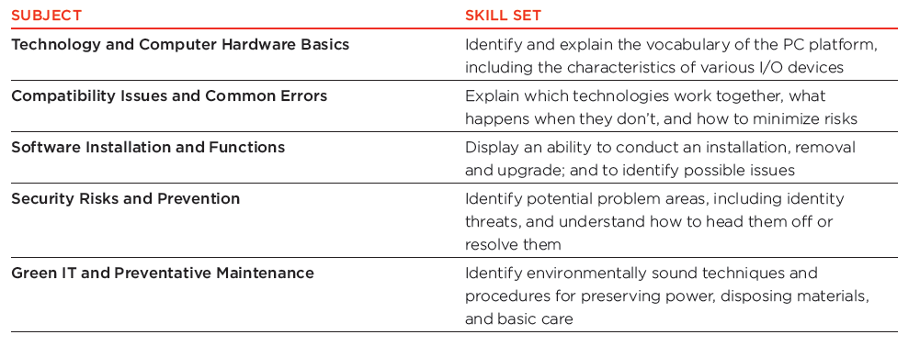
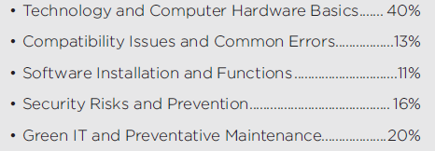
Exam Objectives

Slide 44
CompTIA Strata Exam Characteristics
This is what to expect -
Multiple-choice and other linear questions
60 minute length
70 test items
Score required to pass = 70%
Skills measured are posted on CompTIA
website

Slide 45
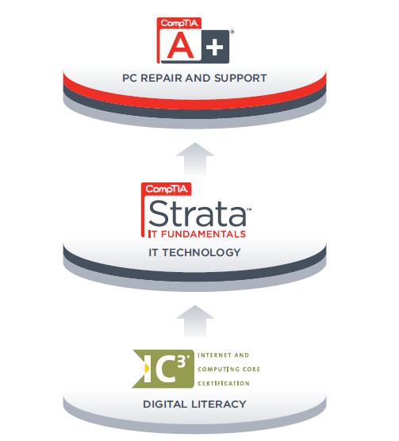
Digital Literacy to Tech Literacy

Slide 47
Microsoft IT Certification
Master + Architect/Consulting Skills
MCA
Master
Professional
Specialist
Associate
Deep Technical Skills
Job Role Experience
1-2 Yrs. Technology Experience.
Beginners
  Associate Level:
  No experience
  Fundamental concepts
  Classroom taught
  Available to academic institutions only
  Positioning students for advanced training, MCTS and entry-level positions and internships

Slide 48
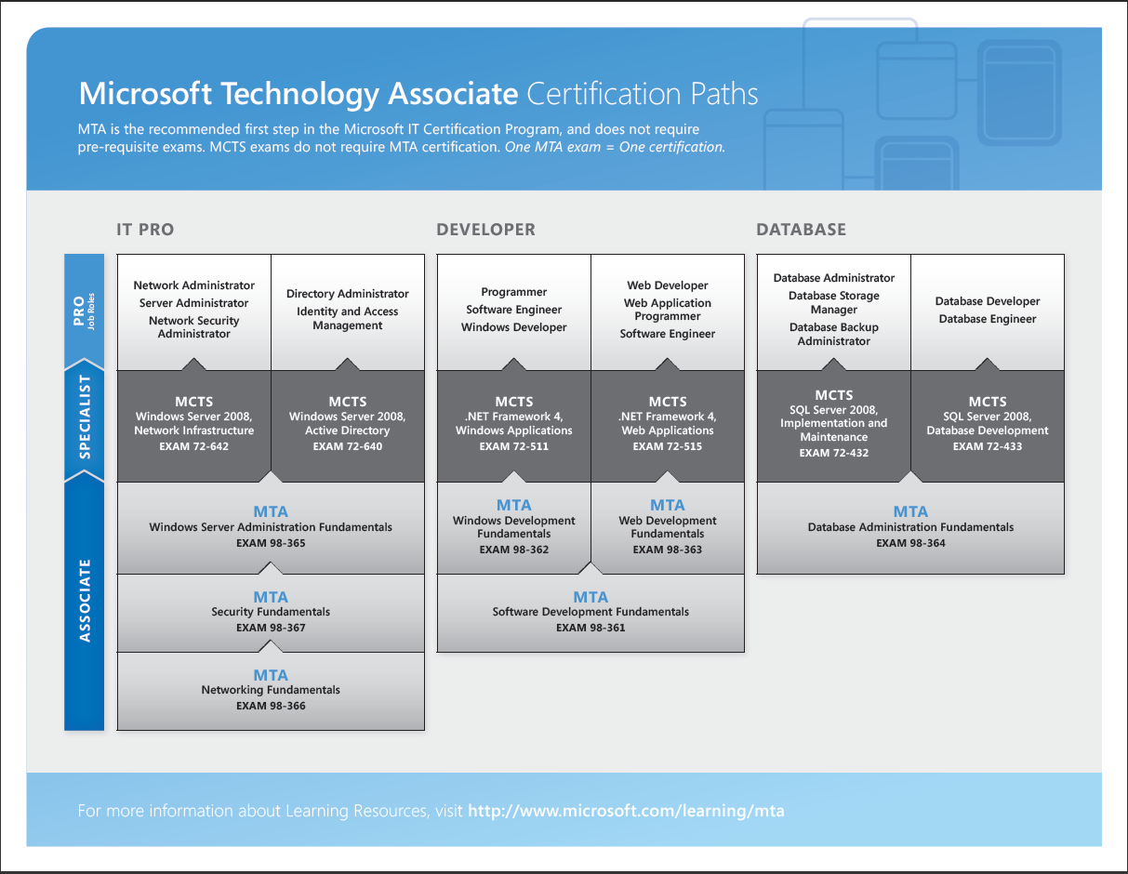

Slide 49
MTA Objectives At A Glance
  MTA validates technology foundation concepts in a version-agnostic way. The main topics for developer titles are:
Software Developer Fundamentals
Understanding core programming
Understanding object-oriented programming
Understanding general software development
Understanding web applications
Understanding desktop applications
Understanding databases
Windows Developer Fundamentals
Understanding Windows programming basics
Creating Windows Forms applications
Creating WPF applications
Creating Windows Services applications
Accessing data in a Windows Forms application
Deploying Windows application
Web Developer Fundamentals
Programming web applications
Working with data and services
Troubleshooting and debugging web applications
Working with client-side scripting
Configuring and deploying web applications
Database Administration Fundamentals
Understanding core database concepts
Creating database objects
Manipulating data
Understanding data storage
Administering a database
  Exams were defined based on career tracks with high demand in the industry. Specific topics were designed by MSL experts and vetted with college instructors.

Slide 50
MTA Objectives At A Glance
  Main topics for IT Pro titles are:
Windows Server Administration Fundamentals
Understanding server installation
Understanding server roles
Understanding Active Directory
Understanding storage
Understanding server performance management
Understanding server maintenance
Networking Fundamentals
Understanding network infrastructures
  Internet, intranet, extranet, LAN, WAN, wireless, topologies, access methods
Understanding network hardware
  Switches, routers, media types
Understanding protocols and services
  OSI model, IPv4, IPv6, names resolution, networking services, TCP/IP
Security Fundamentals
Understanding security layers
Understanding operating system security
Understanding network security
Understanding security software

Slide 51
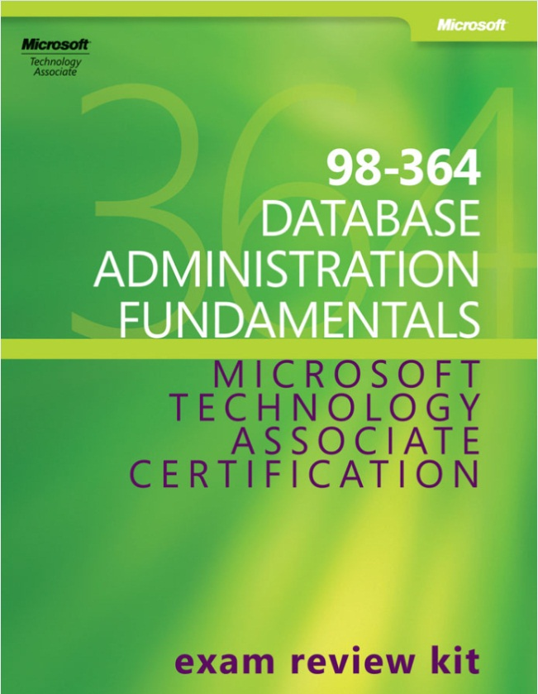
Resources - Exam Review Kits
Educators keep using their favorite courseware. MTA exams and Certification Exam Review Kits supplement and reinforce the content already being taught.

Slide 52
ERK Overview
20 1-hour lessons designed to reinforce course content
Includes lesson plans, presentations, and typically student activities
Includes resources to create additional learning
Intended to supplement (not supplant) existing courses
Not intended to serve as foundational content for academic courses
Platform is directly and closely tied to the objective domain of each MTA exam

Slide 53
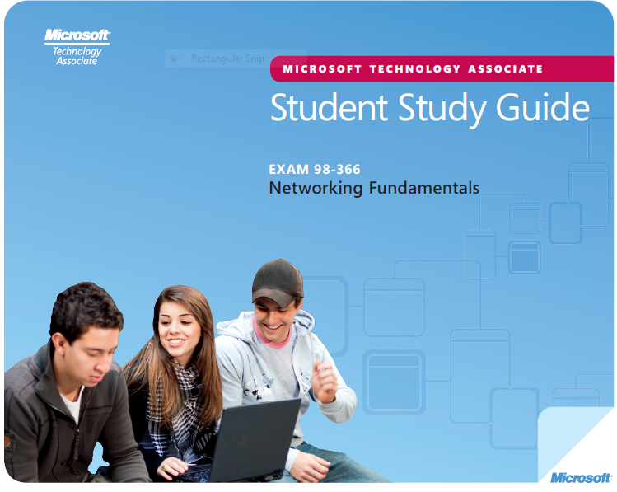
Resources – Student Study Guides
.

Slide 54
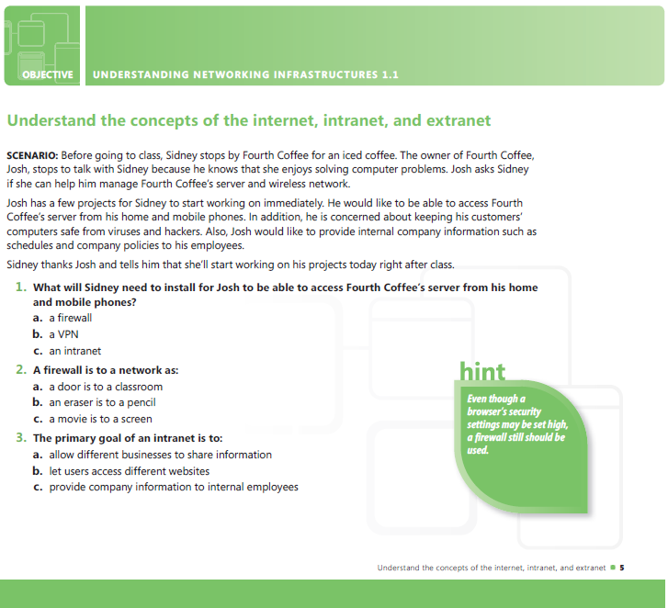

Slide 55


Slide 56
Why QuickBooks Certification?
Required Skills in Business World
85% of small business retail market
80% of accountants recommend
4200+ financial institutions are connected

Slide 57
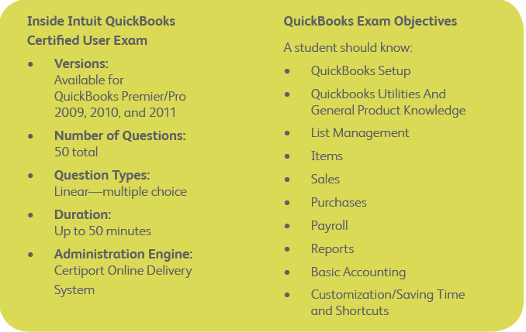
QuickBooks Certified User Exam

Slide 58
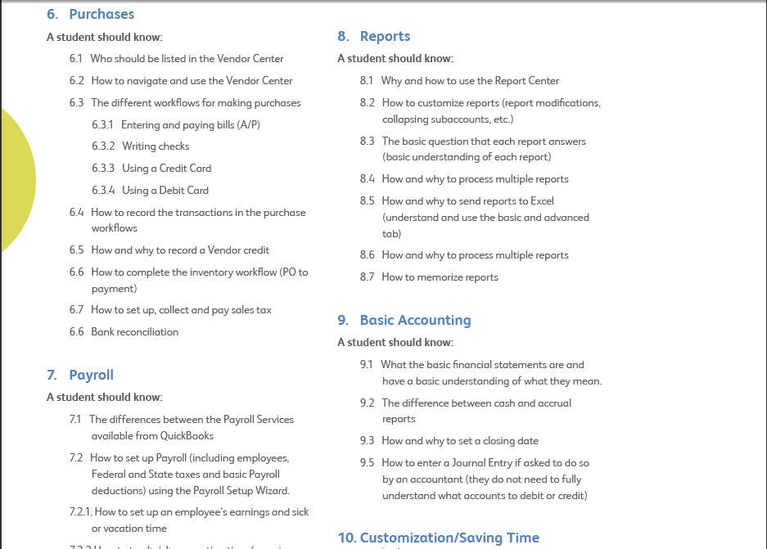
Exam Objectives - Sampling

Slide 60
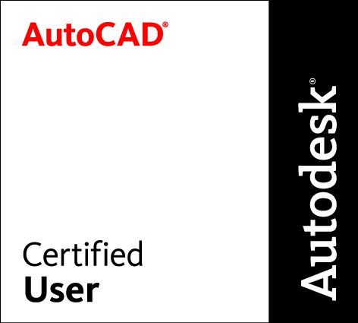
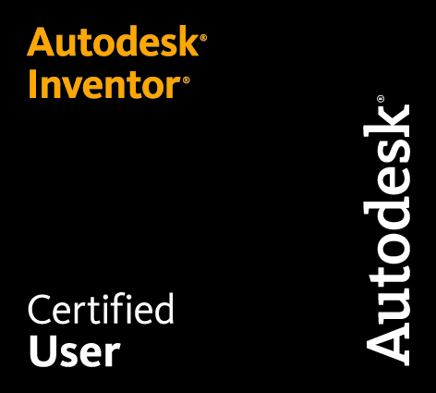
Autodesk Certified User
2D and 3D design program certifications
Mix of multiple-choice, & simulations
45-50 minute length
Version agnostic exams – based on ribbon format

Slide 61
Other Credentials

Slide 62
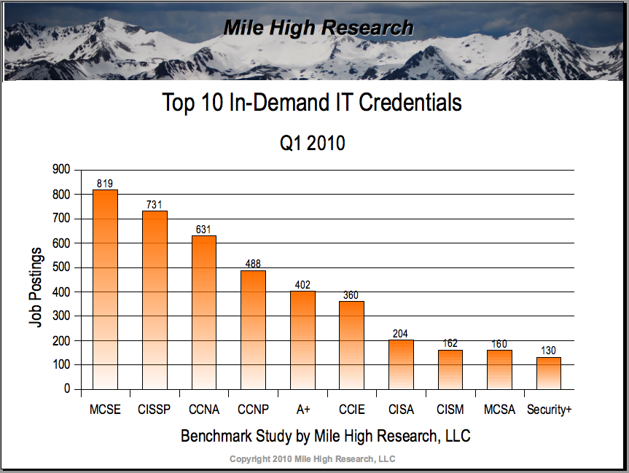

Slide 63
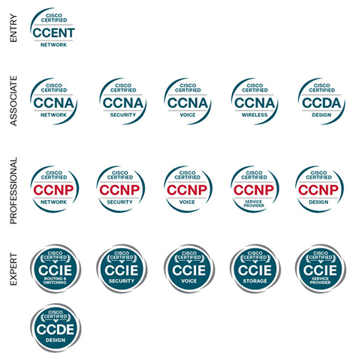
CISCO Certifications

Slide 64
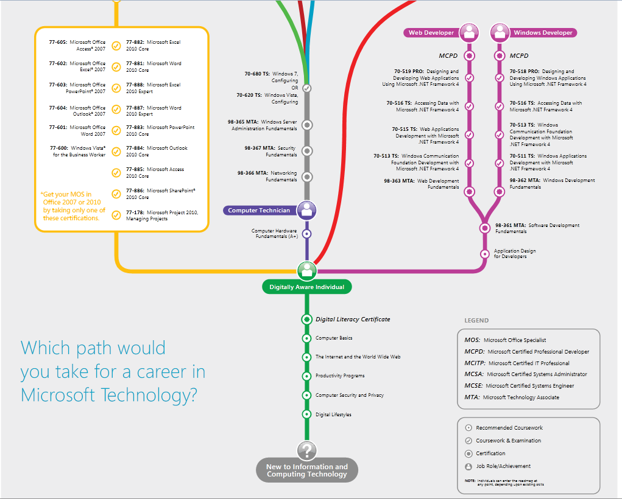

Slide 65
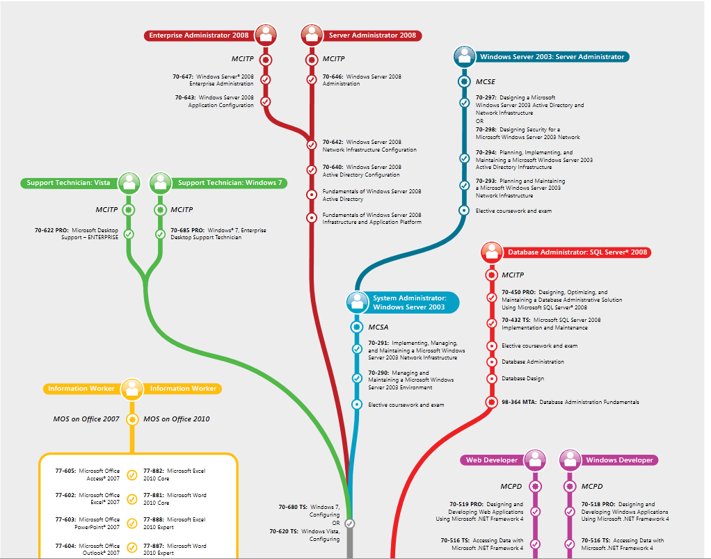

Slide 66

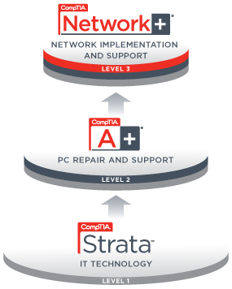



CompTIA Certifications

Slide 67
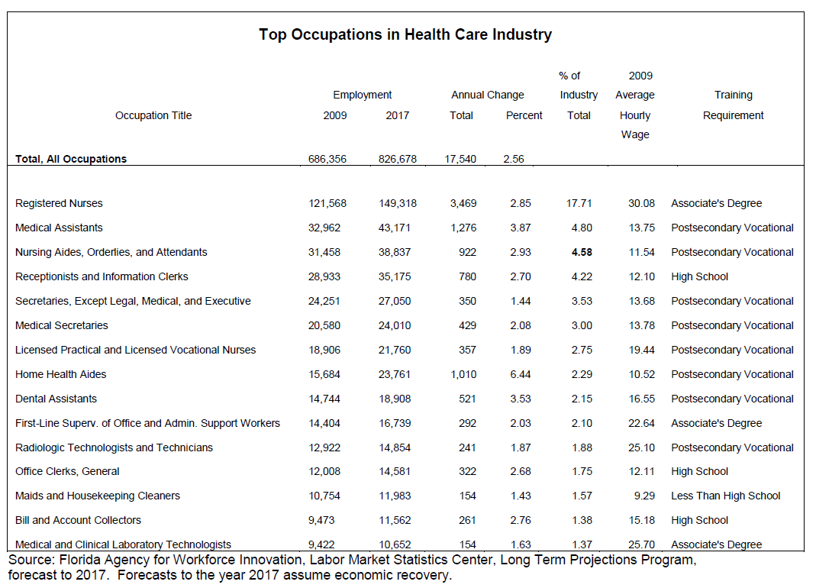

Slide 68
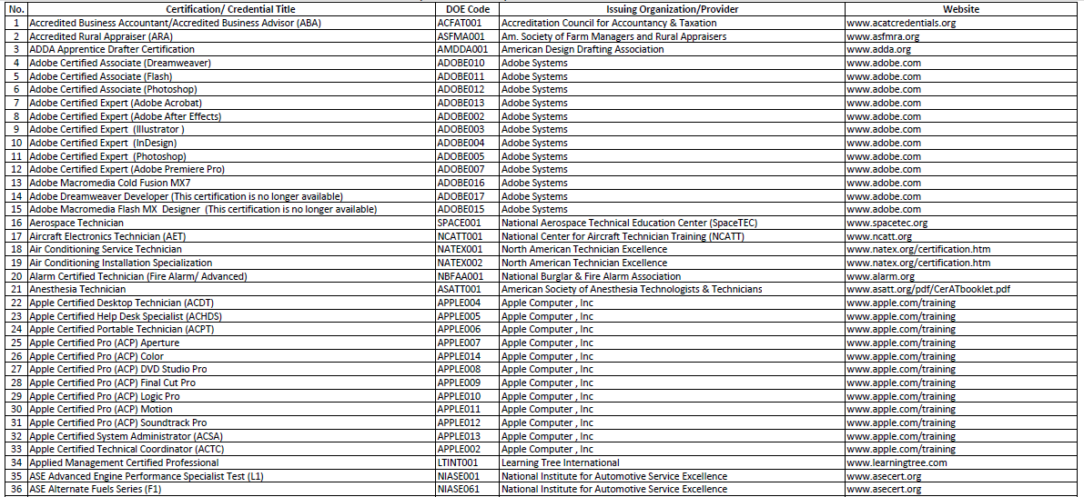
Florida CAPE Certification List
65% of all FL CAPE Certifications…
http://www.workforceflorida.com/PrioritiesInitiatives/EducationalInitiatives/cape/CAPE2010-11-FinalCondensedVersionJBupdated8-6-10.pdf

Slide 69
Getting Started with Certifications

Slide 70
Step 1: Identify Standards to Integrate

Slide 71
Step 2: Evaluate Curriculum Alignment
Review Industry Standards
Compare Industry Standards to Course Objectives & Identify Gaps
Create Remedial Training/Learning Exercises
Or Identify Better Aligned Curriculum*

Slide 72

Step 3: Identify Funding

Slide 73
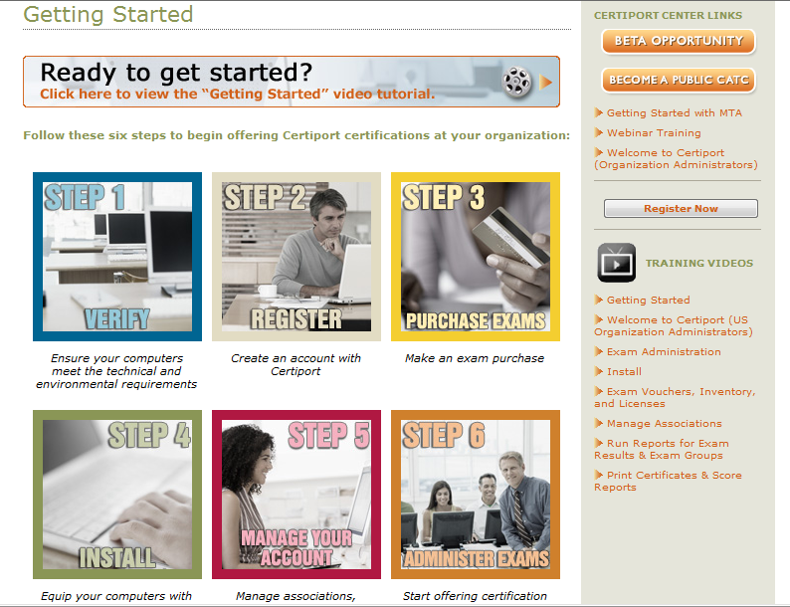
Step 4: Go to www.Certiport.com/go

Slide 74
Resources for You
Certiport Customer Success Team
  Helps you through the initial setup and training process
Certiport Regional Managers (Brent and Bryan)
  Help you with product, program, curriculum questions
Certiport Technical Support
  24x7 technical support if you have any setup concerns
CDE/CPA Contacts, BEP, Industry Sector Leads
  Steer you in the right direction, provide insights

Slide 75
Questions?

Slide 76
Thank You!
 | Dave Hansen Director, Product Operations - Microsoft MCT, MMI, CPI, IC3 AI, MOS, CompTIA Strata Direct Line: 801.847.3167 Toll Free: 888.999.9830 x167 Mobile: 801.369.3109 Email: dhansen@certiport.com

